Slide 1
Introduction to Modern Computer Graphics
Li Manyi, Ma Long
School of Software
Shandong University

Slide 2

QQ课程群

Slide 3

Luxo Jr.
Pixar Animation Studios, 1986
Director: John Lasseter

Slide 4
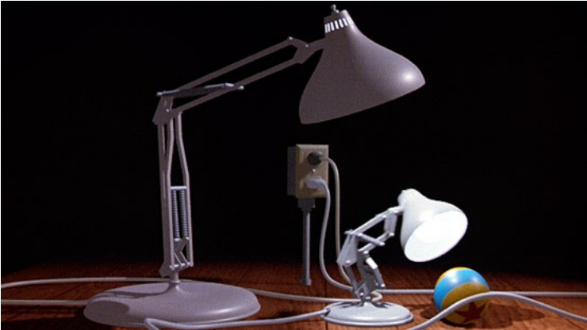
How to make it?
Modeling
Geometry
Materials
Lighting
Animation
Make it move
Rendering
I.e., draw the picture!
Lighting, shadows, textures...

Slide 5
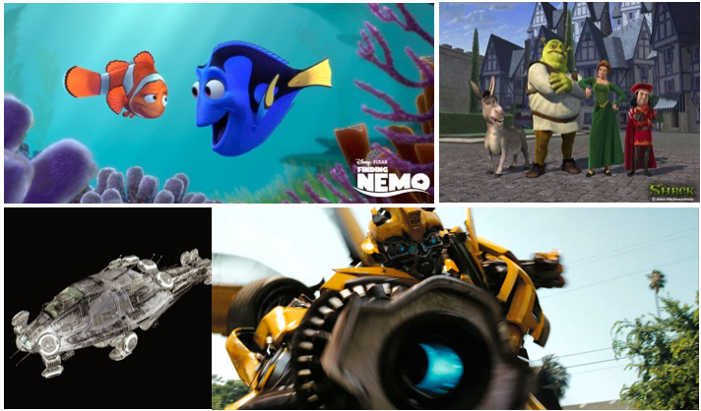
Applications of Computer Graphics
Movies

Slide 6
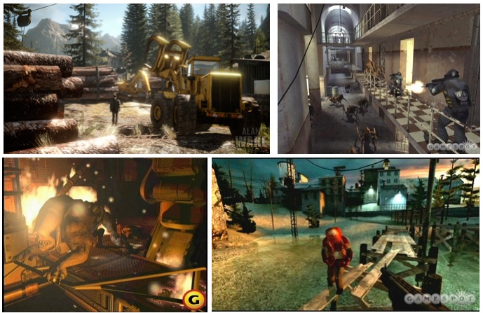
Video Games

Slide 7
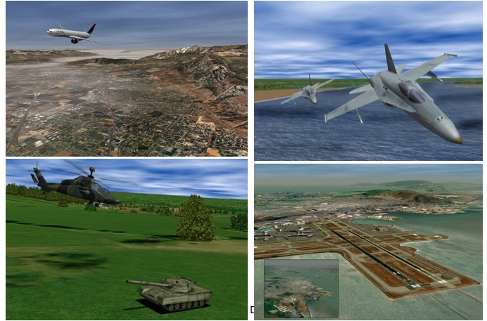
Simulation

Slide 8
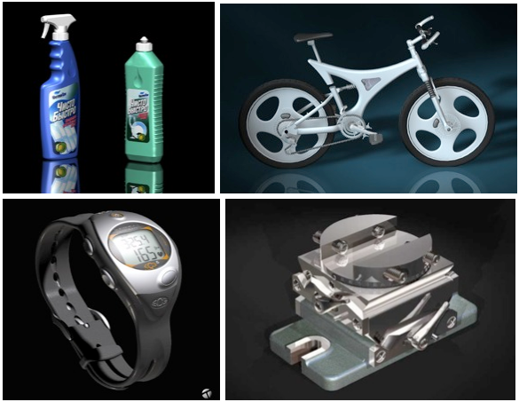
CAD-CAM

Slide 9
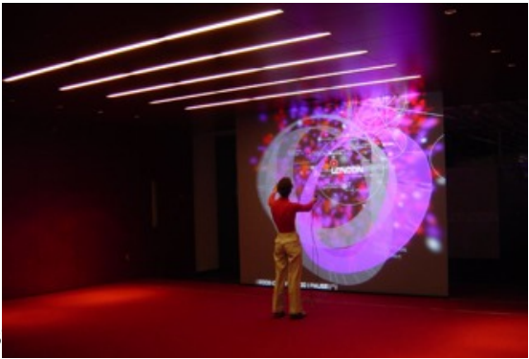
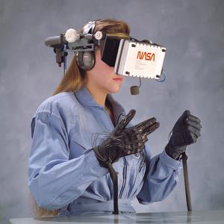
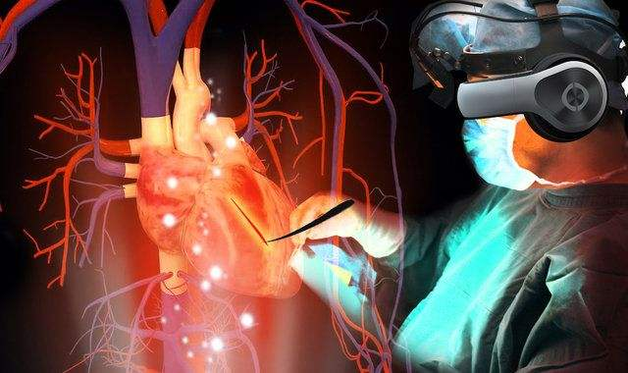
Virtual Reality

Slide 10
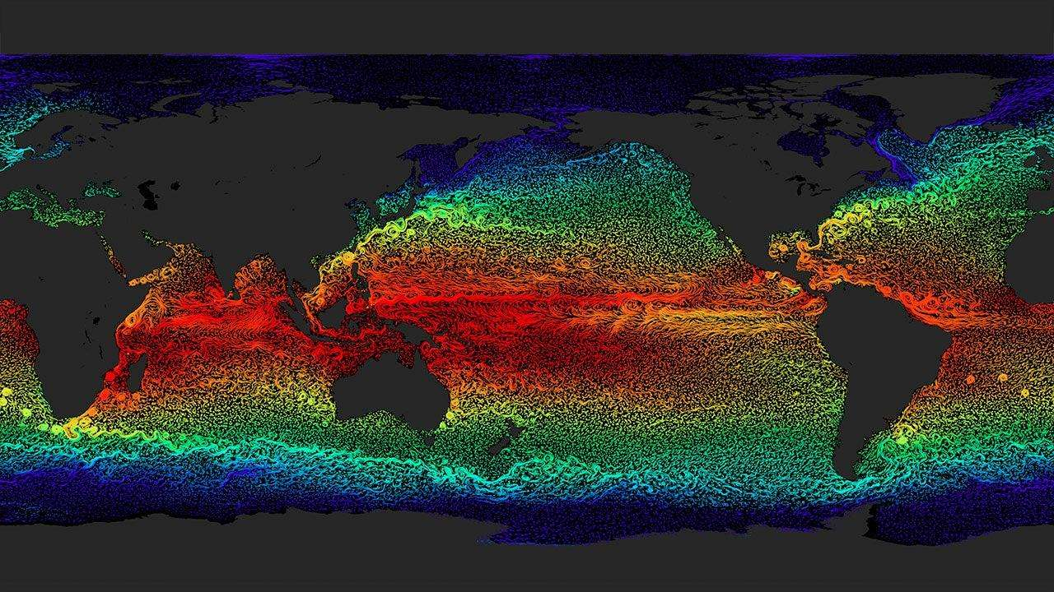
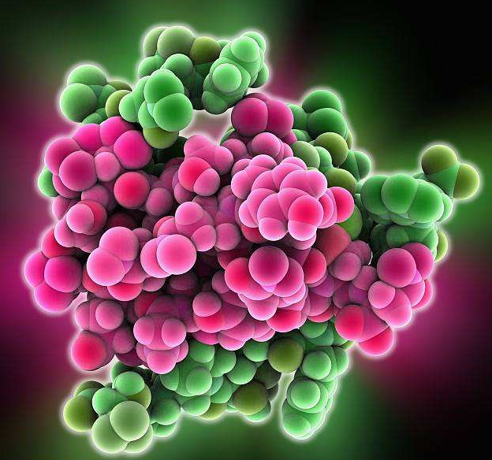
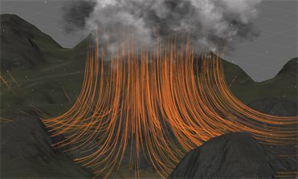
Visualization

Slide 11
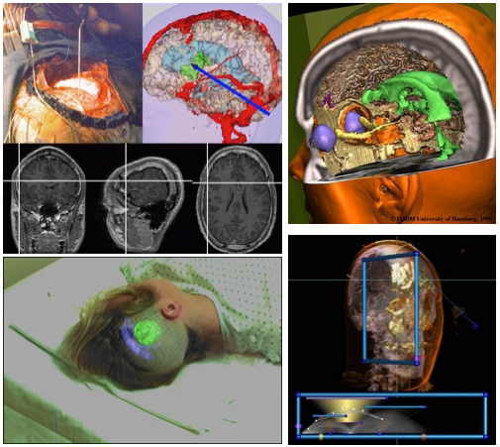
Medical Imaging

Slide 12
What Makes Graphics Fun?
Very interdisciplinary – CS, math, physics, art, perception
Helps you understand why the world looks the way it does
You can “see” the result
You can “cheat” with reality as long as it looks good

Slide 13
What you will learn in this course?
Fundamentals of computer graphics algorithms
We’ll concentrate on 3D, not 2D illustration or image processing
Basic OpenGL
Not the focus, though
You will get C++ programming experience

Slide 14
Topics for the Semester
Modern Graphics Pipeline
Modeling
Mesh representation, generation, and simplification
Surface subdivision
Volumetric modeling
Animation
Skeleton
Skinning
Forward/inverse kinematics
Simulations
Particle systems, cloth/water
Rigid body, deformation
Collision detection
Rendering
ray tracing
local vs. global illumination

Slide 15
Prerequisites
Data structure
Algorithm design & analysis
C++ programming
Calculus, Linear Algebra
Solving equations, derivatives, integral
vectors, matrices, basis
……

Slide 16
Grading
Final exam
Programming
OpenGL program 1: warm up (2D)
OpenGL program 2: driving a car (3D + interaction)
Mesh surface subdivision

Slide 17
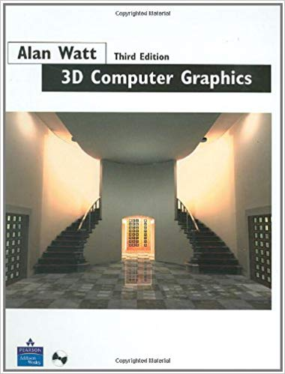
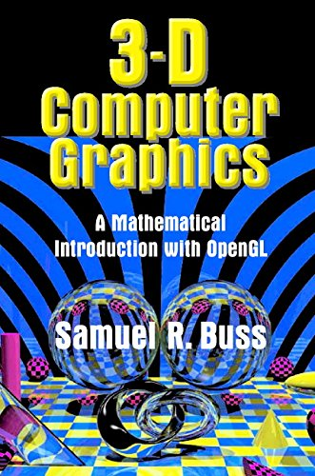
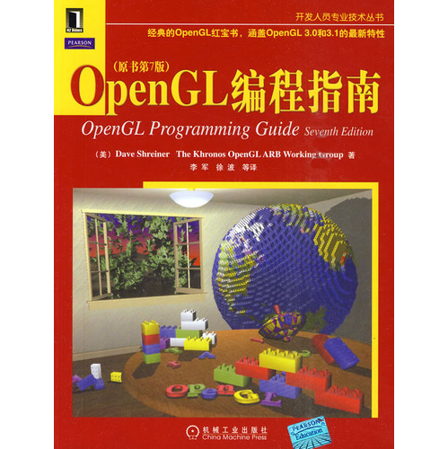
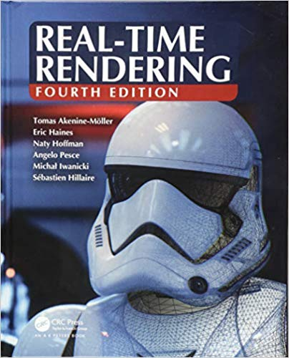
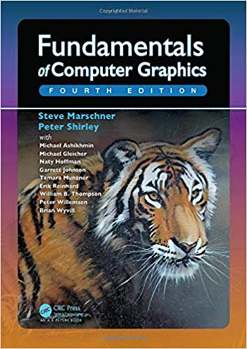
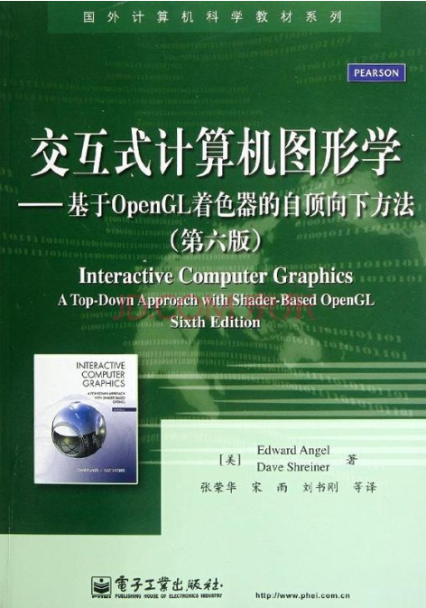
Textbooks
交互式计算机图形学-基于OpenGL着色器的自顶向下方法，电子工业出版社，2012年
OpenGL编程指南，机械工业出版社，2012年
Recommendations
3D Computer Graphics (Watt)
3D Computer Graphics: A Mathematical Introduction with OpenGL (Buss)
Real-Time Rendering, 4th ed. (Akenine-Möller, Haines, Hoffman)
Fundamentals of Computer Graphics, 4th ed. (Shirley, Marschner)
……

Slide 18
Contact Information
Email: manyili, malong@sdu.edu.cn
Office: Digital Media Building 416, Research Building 315

Slide 19
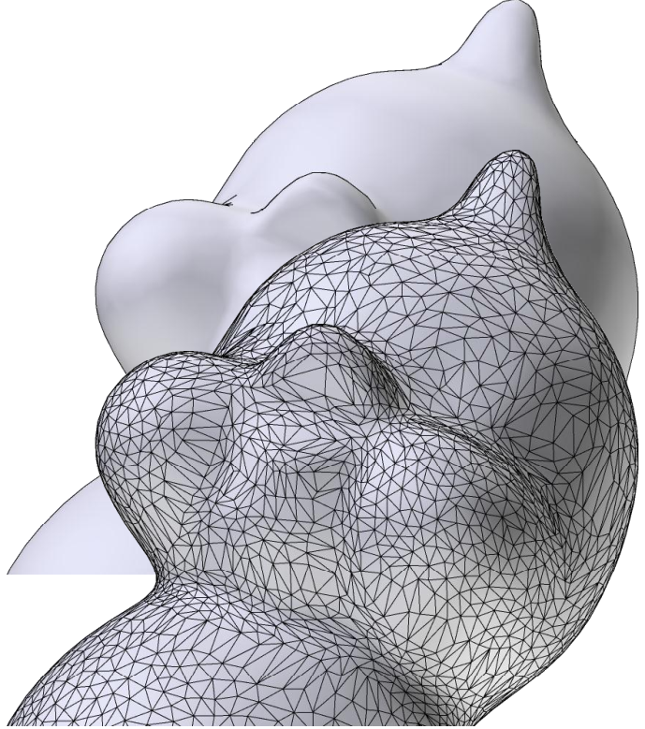
Introduction to OpenGL
OpenGL is an API that allows you to send commands to the graphics card to draw 2D or 3D scenes
Scene represented as triangles
A triangle is a set of 3 vertices
A vertex is a set of 3 floating point numbers (x, y, z)
We will use OpenGL to send this to the graphics card (GPU)
The GPU will do its magic to display the scene from the current viewpoint (Later, we will get to see how this happens)

Slide 20
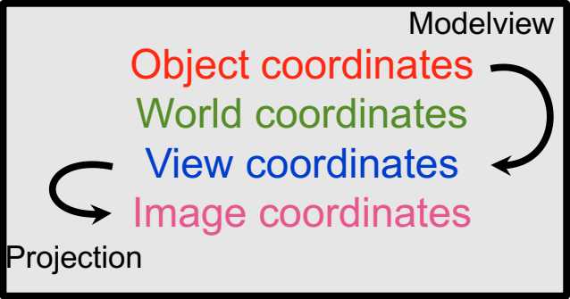
How to draw?
You need to tell OpenGL
The geometry of the object
Vertex positions
Vertex normal
3 vertices make a triangle!
Camera parameters
Field of view, aspect ratio, (depth range)
The “projection matrix”

Slide 21
OpenGL high-level pseudocode
Initialize
(get graphics context, etc.)
For each frame
Manage UI
Set appropriate viewpoint
Set light source directions
For each triangle For i=0 to 2 Send vertex data

Slide 22
OpenGL Example: Viewing
//Current matrix affects objects positions
glMatrixMode(GL_MODELVIEW);
glLoadIdentity();
//Position the camera at [0, 0, 5], looking at [0, 0, 0] with [0, 1, 0] as the up direction
gluLookAt(0.0, 0.0, 5.0, 0.0, 0.0, 0.0, 0.0, 1.0, 0.0);
//Rotate by -20 degrees about[0, 1, 0]
glRotated(-20, 0.0, 1.0, 0.0);
//Draw a teapot
gluSolidTeapot(1.0);

Slide 23
Vertex data
What information do we need at each vertex?
Coordinates (3 floats)
Color (optional, 3 floats)
Normal information (optional, 3 floats)
Transparency (optional, 1 float)
More to come (texture information, shininess)

Slide 24
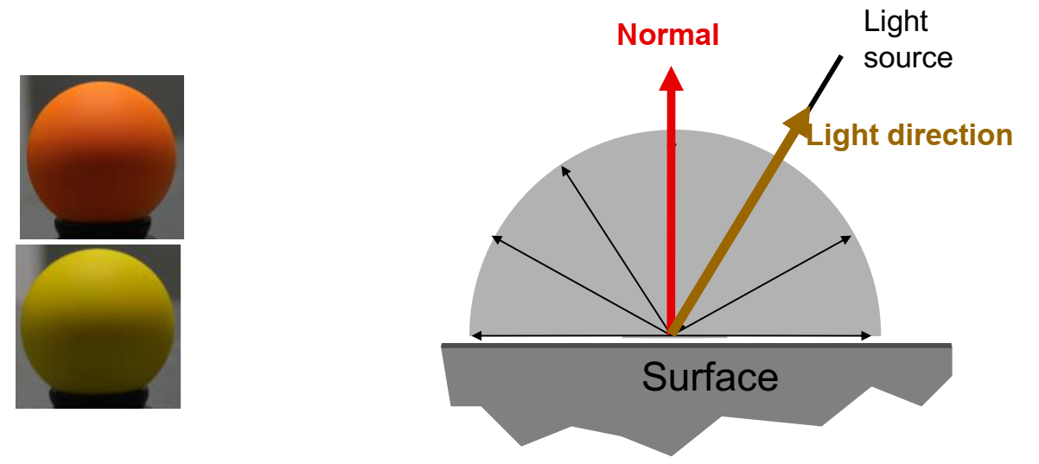
Why normals?
To compute color as a function of light direction
Simplest: Diffuse or Lambert model
Intensity = dot product (normal, light direction)

Slide 25
OpenGL Code
glBegin(GL_TRIANGLES); //what follows describes triangles
glColor3d(1, 1, 0); //red, green and blue components=>(yellow)
glNormal3d(0, 0, 1); //normal pointing up
glVertex3d(2, 2, 3); //3D position x, y, z
glColor3d(1, 0, 0);
glNormal3d(0, 0, 1);
glVertex3d(5, 3, 3);
glColor3d(1, 0, 1)
glNormal3d(0, 0, 1)
glVertex3d(3, 6, 3)
glEnd();

Slide 26
OpenGL is a state machine
Each command changes the state
But glVertex also “pushes” data
For example, glColor3f changes the current color.
The color remains valid until we call glColorxx again
Use it before each vertex to get per-vertex color.
Other state to manage lighting and other rendering aspects
Can make it hard to debug

Slide 27
相关专业词汇列表
geometry 几何(geo，地质，metry来自meter，测量)
material 材质(来源于matter物质，材料)
animation 动画(anima词根与运动有关，例如animal)
texture 纹理(来源于text文本)
render 渲染(法语中的render意思是“成为”)
illustration 插图(来源于illustrate图示)
interdisciplinary 跨学科的(inter交叉，discipline学科)
perception 感知(per完全 cept贯穿)

